Slide 1
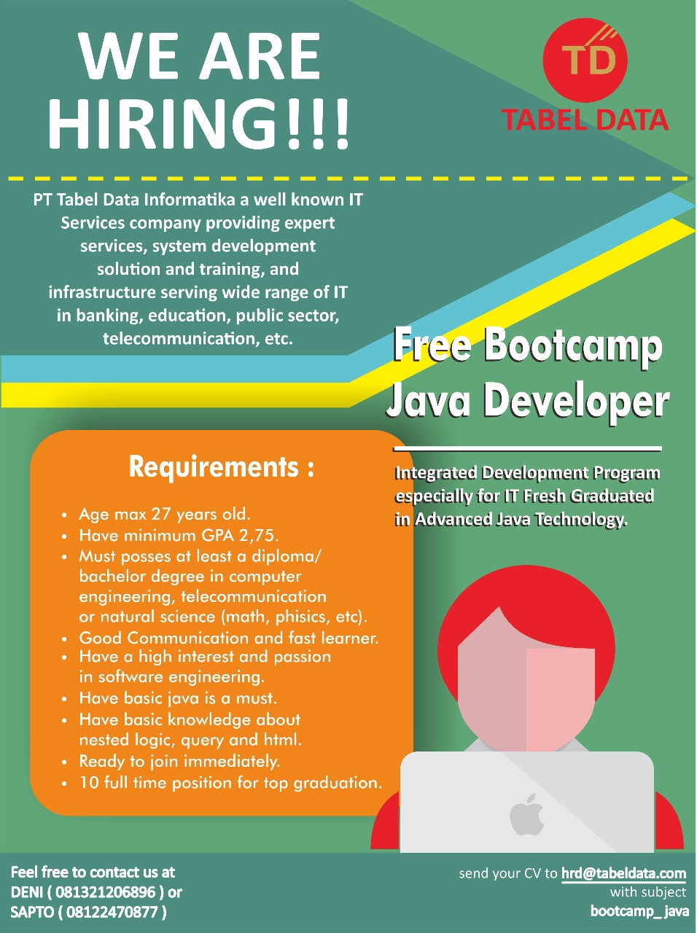
Bootcamp Java Developer #Day 4
PT. Tabel Data Infromatika
By Dimas Maryanto,S.Kom

Slide 2
Javascript
JavaScript (JS) is a lightweight interpreted or JIT-compiled programming language with first-class functions. While it is most well-known as the scripting language for Web pages, many non-browser environments also use it, such as node.js, Apache CouchDB and Adobe Acrobat. JavaScript is a prototype-based, multi-paradigm, dynamic language, supporting object-oriented, imperative, and declarative (e.g. functional programming) styles. Read more about JavaScript.
https://developer.mozilla.org/en-US/docs/Web/JavaScript

Slide 3




Setup Development Environtment

Slide 4
Tipe Data
String
Number
Boolean
Array
Object / JSON
Null
Undefined

Slide 5
Operator
Addition (+), Substration (-), Multiplication (*), Division (/)
Assigment (=)
Equality (===)

Slide 6
Condition & Looping
Condition
Looping
IF
Switch
For
Do While
While
for ... in

Slide 7
Function Declaration or Function Statement

